Slide 1
Communicative English
Verbals - Gerunds, infinitives and participles

Slide 2
What is a Verbal?
words that are formed from a verb, but are used as a noun, adjective, or an adverb.
Examples:
To study (infinitive) or not to study (infinitive) is a decision students make.
Studying (gerund) is hard work.
The student, studying diligently (participle), received all A’s.

Slide 3
Participles
A participle is a verb form that can be used as adjective.
Participles end in –ing, -ed, -d, or –t, and are used as an adjective (describes noun or pronoun).
1
Basically, it is a verb form used as an adjective that modifies nouns and pronouns.

Slide 4
Participle Example
1
The children, crying and exhausted, were guided out of the collapsed mine. (Both participles modify the subject, children.)
Crying is a present participle, formed by adding - ing to the present form of the verb (cry).
Exhausted is a past participle, formed by adding –ed to the present form of the verb (exhaust).

Slide 5
Participial Phrase
A participial phrase is made up of a participle and its modifiers. The entire phrase is used as an adjective.
Example:
Located in front of noun:
Holding the torch steady, Mary approached the monster.
Located after the noun or pronoun:
Mary, holding the torch steady, approached the monster.
The participial phrase consists of a present participle (holding), an object (the torch), and an adverb (steady).

Slide 6
Gerund
A gerund looks like a verb, ends in –ing; used as a noun.
It was once a verb but has become a noun.
Look similar to a participial phrase because they both can end in –ing.
REMEMBER: A gerund functions as a noun, and a participle functions as an adjective.

Slide 7
Uses of Gerunds
Used as a noun:
Subject: Swimming is a great form of exercise.
Subject Complement: A great form of exercise is swimming.
Object of Preposition: Before swimming in a lake, …
Direct Object: He likes swimming in the ocean.
Indirect Object: (You) Give swimming a chance.

Slide 8
Gerund phrases
*Gerund phrases consist of a gerund and any objects and/or modifiers.
Ex. I enjoy riding my bike in the evening.
The phrase is used as a direct object.

Slide 9
Infinitives 1
An infinitive is a verb form that can be used as a noun, an adjective, or an adverb. Most infinitives begin with to + verb.
Ex. I don't like to cry in public unless I'm getting paid for it.
“to cry” is the infinitive

Slide 10
Infinitive Phrases
Infinitive phrases consists of an infinitive and is followed by any objects, and/or modifiers. The entire phrase may be used as a noun, an adjective, or an adverb.
Ex. I must study to pass my winter exams with good marks.

Slide 11
Infinitives used as adjective
The best time to visit (modifies Florida) Florida is December through April.
If you want information about computers, that is the magazine to read (modifies magazine).
Peanuts and raisins are good snacks to take on a camping trip (modifies snacks).

Slide 12
Infinitives Used as noun
To install (subject) the ceiling fan took two hours.
Winona’s ambition is to become (predicate nominative) a doctor.
Shina likes to skate (direct object) but not to ski (direct object).
To lift these weights (used as a subject) takes great strength.

Slide 13
Infinitives used as adverb
The gymnasts were ready to practice (modifies the adjective ready) their routines.
The camel knelt at the pool to drink (modifies knelt).
The crowd grew quiet to hear the speaker (modifies the verb grew).

Slide 14
Observe the following statements
Defeated teams should congratulate the winners.
Past participle
The crying baby hid under the table.
Present participle
I saw her fishing contentedly.
Participial phrase
Walking is a good exercise.
Gerund
I dislike talking loudly in the corridor.
Gerund phrase

Slide 15
Observe the underlined infinitive used as a noun, adjective, or adverb
Mrs. Chisolm rose to speak (adverb).
To forget is to forgive.
noun
That was a day to remember.
adjective
Remember, an infinitive phrase consists of an infinitive together with its complements and modifiers. See below:
.
To interrupt a speaker abruptly is impolite.

Slide 16
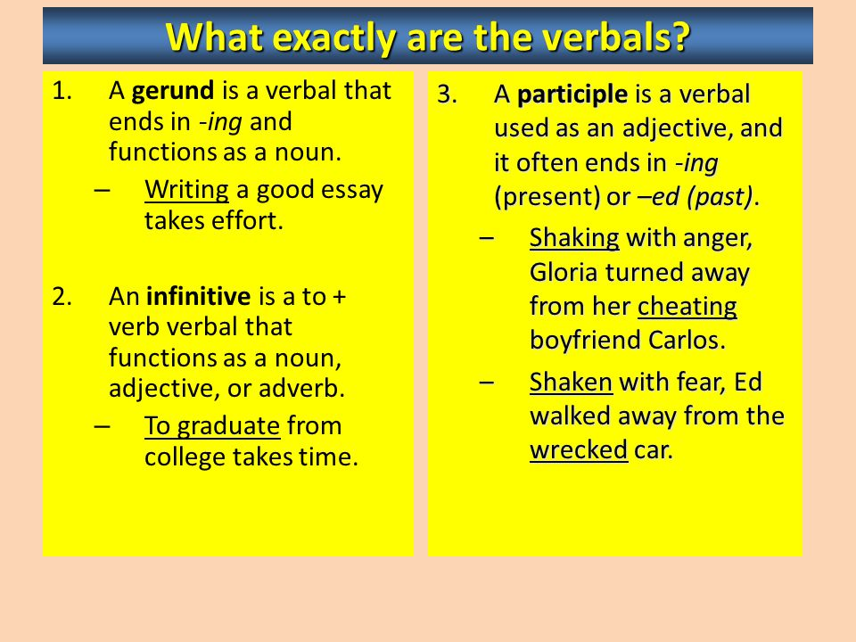
In short

Slide 17
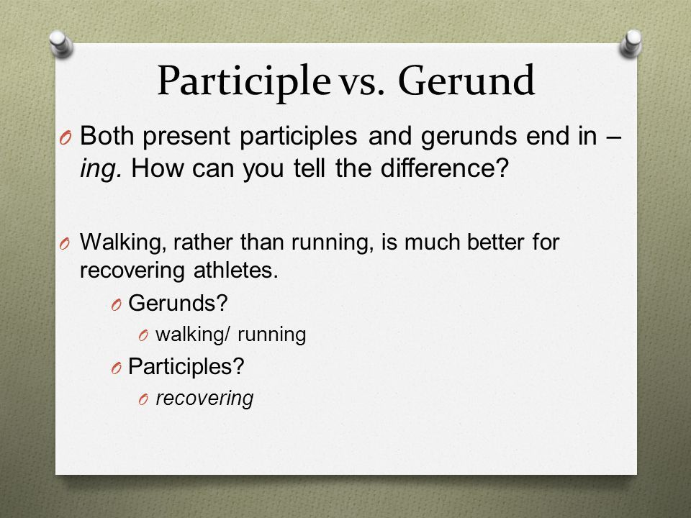

Slide 18
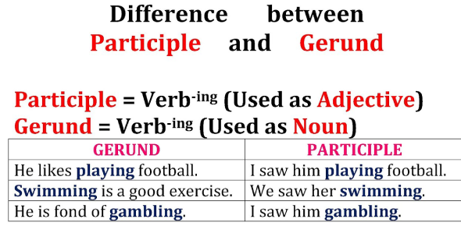

Slide 19
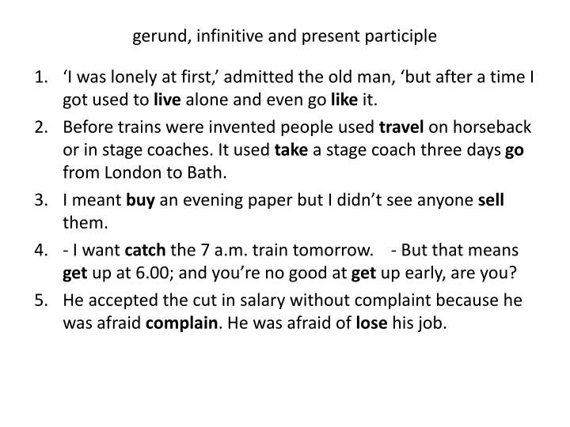
What is wrong with these sentences ?

Slide 20
Thank you
Dr. Kiran Magavi

